Slide 1







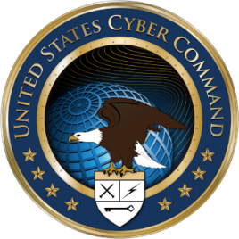






Slide 2
National Guard Cyber Support
SSG Jason Adsit
Oregon Army National Guard
Mr. Courtney Ramsey
Oregon Titan Fusion Center
Notes:
Meet and Greet
Formal Introductions
Level-Set

Slide 3
Cyber Initiatives in Oregon
In September 2016, Governor Kate Brown issued Executive Order No. 16-13 entitled “Unifying Cyber Security in Oregon”
In July 2017, Senate Bill 90 was enacted.
Unification of agency information technology security functions.
State agency coordination
Oregon Cybersecurity Advisory Council
Oregon Cybersecurity Center of Excellence
Authority of State Chief Information Officer to enter into agreements
Moneys from federal government and other sources
In July 2018, the ORNG’s DCOE began working with the OTFC to improve the quality and timeliness of cyber intelligence sharing with SLTT partners.
In fall 2018, the DCOE will coordinate with the Oregon Secretary of State’s security team with regard to cybersecurity of election infrastructure.

Slide 4
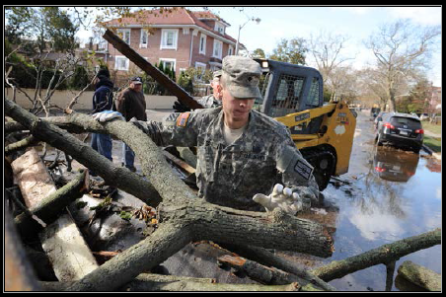
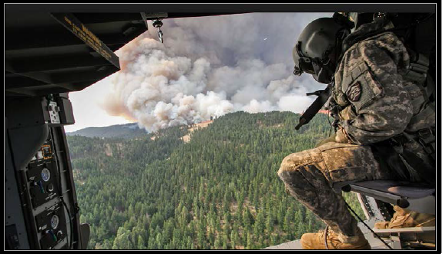
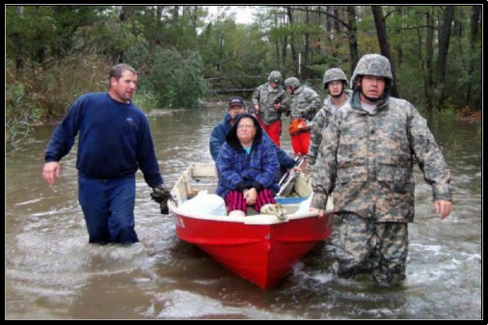
Traditional National Guard Missions
The Guard has a unique dual mission, with both federal and state responsibilities. During peacetime, Guard forces are commanded by the governor through a state adjutant general.
The governor can call the Guard into action during local or state-wide emergencies, such as storms, drought and civil disturbances.
Notes:
Talk about floods, fires, etc.

Slide 5
Duty Statuses Applicable to the National Guard
STATE
FEDERAL
Notes:
National Guard unit personnel may operate in a Title 10 status, a Title 32 status, or a state active-duty status. Personnel in a Title 10 status are federally funded and under the command and control of the President. Personnel in a Title 32 status are federally funded but under the command and control of the governor. National Guard personnel could support DOD’s DSCA mission while in a Title 10 or Title 32 status. National Guard teams also conduct activities to coordinate, train, advise, and assist (CTAA) civil authorities in a Title 32 or State Active Duty (SAD) status.

Slide 6
Cyber Mission Types
Ongoing example: ORNG partnership with ESO and the OTFC to perform Cyber assessments for State customers (i.e. Counties, Cities, Schools, etc..), in order to increase their cyber posture.
As Needed: State directed SAD and Title 32 missions to support CTAA. Guidance for these missions are dictated by DoD Policy Memo 16-002.
Title 32 Missions must not interfere with ORNG training requirements or unit readiness.
SAD Missions must be authorized by the Governor and pre-funded or reimbursed by the supported entity
Acronyms:
DCOE – Defensive Cyberspace Operations Element ESO – Enterprise Security Office
CTAA – Coordinate, Train, Advise, and Assist DSCA - Defense Support of Civil Authorities
OEM – Office of Emergency Management OMD – Oregon Military Department
SAD – State Active Duty JRIC – Joint Regional Intelligence Center
DAS – Department of Administrative Services OTFC – Oregon Titan Fusion Center
NTOC – NSA/CSS Threat Operations Center NCCIC – National Cybersecurity and Communications Integration Center

Slide 7
Mission Roles and Responsibilities
During a large scale cyber event, the Governor will activate NG cyber teams to assist State, Local, Tribal, and Territorial governments with combating cyber-attacks and restoring critical Industrial Control Systems – Supervisory Control and Data Acquisition (ICS-SCADA) infrastructure (i.e. dams, power plants, mass transit) and services lost or damaged resulting from cyber-attacks.
Deputy SECDEF Policy Memo 16-002: Cyber Support and Services Provided Incidental to Military Training and National Guard Use of DoD Information Networks, Software, and Hardware for State Cyberspace Activities.
Presidential Policy Directive 21 (PPD-21): Critical Infrastructure Security and Resilience, signed June 2013, identified 16 critical infrastructure sectors:
Chemical
Commercial Facilities
Communications
Critical Manufacturing
Dams
Defense Industrial Base
Emergency Services
Energy
Financial Services
Food and Agriculture
Government Facilities
Includes Cybersecurity of Election Infrastructure
Healthcare and Public Health
Information Technology
Nuclear Reactors, Materials, and Waste
Transportation Systems
Water and Wastewater Systems

Slide 8
Additional Talking Points
Cyber Incident Severity Schema
Information Sharing and Analysis Organization
NSA/DHS National Centers of Academic Excellence (CAE)
Cyber Storm and Cyber Shield
Cybersecurity of Election Infrastructure
Notes:
Cyber Incident Severity Schema:
The United States Federal Cybersecurity Centers, in coordination with departments and agencies with a
cybersecurity or cyber operations mission, adopted a common schema for describing the severity of
cyber incidents affecting the homeland, U.S. capabilities, or U.S. interests. The schema establishes a
common framework for evaluating and assessing cyber incidents to ensure that all departments and
agencies have a common view of:
- The severity of a given incident;
- The urgency required for responding to a given incident;
- The seniority level necessary for coordinating response efforts; and
- The level of investment required of response efforts.
NSA/DHS National Centers of Academic Excellence (CAE):
Centers of Academic Excellence in Cybersecurity are institutions that have met rigorous requirements, and through careful evaluation are designated as CAE in Cybersecurity. An institution or program must apply to be a CAE every five academic years.

Slide 9
Contact Information
SSG Jason Adsit
Cyber Operations NCO Defensive Cyber Operations Element (DCOE) Oregon Army National Guard 503-584-3945 jason.l.adsit.mil@mail.mil
Group Email: ng.or.orarng.list.j6-dcoe@mail.mil
Mr. Courtney Ramsey
Intelligence Analyst Urban Area Security Initiative (UASI) Oregon Titan Fusion Center 503-934-2062 courtney.d.ramsey@doj.state.or.us
Group Email: oregonfusioncenter@doj.state.or.us

Slide 10
References
National Cyber Incident Response Plan (NCIRP): https://www.us-cert.gov/ncirp
SLTTGCC Cyber Resource Compendium: https://www.dhs.gov/publication/slttgcc-cyber-resource-compendium
JP 3-12 - Cyberspace Operations: http://www.jcs.mil/Portals/36/Documents/Doctrine/pubs/jp3_12.pdf
Cyber Incident Severity Schema: https://it.ojp.gov/GIST/178/File/Cyber%20Integration%20for%20Fusion%20Centers.pdf#page=29
NCCIC Cyber Incident Scoring System: https://www.us-cert.gov/sites/default/files/publications/NCCIC_Cyber_Incident_Scoring_System.pdf
National Guard Cyber Defense Teams: http://www.nationalguard.mil/Portals/31/Resources/Fact%20Sheets/NG%20Cyber%20Defense%20Team%20Fact%20Sheet%20(Dec.%202017).pdf
DTM 17-007 – Interim Policy and Guidance for Defense Support to Cyber Incident Response http://www.esd.whs.mil/Portals/54/Documents/DD/issuances/dtm/DTM-17-007.pdf
CNGBI 3000.04 – National Guard Bureau Domestic Operations http://www.ngbpdc.ngb.army.mil/pubs/CNGBI/CNGBI%203000.04_20180124.pdf
Cybersecurity Act of 2015 https://intelligence.house.gov/sites/intelligence.house.gov/files/documents/jes%20for%20cybersecurity%20act%20of%202015.pdf

Slide 11
References (Continued)
Oregon Emergency Operations Plan, Incident Annex 10 – Cyber Security https://www.oregon.gov/oem/Documents/2015_OR_eop_ia_10_cyber.pdf
National Exercise Program - Principals’ Objective # 1: Intelligence and Information Sharing https://www.fema.gov/media-library-data/1531316812629-998bade9a8215eda367591b98963c0ec/NEP_PO1_Fact_Sheet_20180330.pdf
National Exercise Program - Principals’ Objective # 4: Cyber Coordination https://www.fema.gov/media-library-data/1531317306234-5d5135caa2604e6e8fea7f4f4f2cb2b6/NEP_PO4_Fact_Sheet_20180330.pdf
National Cyber League https://www.nationalcyberleague.org
NSA/DHS National Centers of Academic Excellence (CAE) Requirements https://www.iad.gov/NIETP/CAERequirements.cfm
Designation of Election Infrastructure as a Critical Infrastructure Subsector https://www.dhs.gov/news/2017/01/06/statement-secretary-johnson-designation-election-infrastructure-critical
Example: California National Guard’s Cyber Network Defense Team Reimbursement Authority http://web1a.esd.dof.ca.gov/Documents/bcp/1819/FY1819_ORG8940_BCP1751.pdf
Example: California National Guard’s Cyber Service Catalog https://cdt.ca.gov/services/wp-content/uploads/sites/2/2017/02/CND-catalog.pdf
NG Cyber Capabilities Overview for Vigilant Guard 2018 https://wss.apan.org/ng/VGCTTX/Shared%20Documents/NG%20Cyber%20Capabilities%20Overview%20for%20VG18.pptx

Slide 13
Backup Slides

Slide 14
DCOE Mission Execution
Prior to the start of the mission, all DCOE team members are required to sign a Non-Disclosure Agreement (NDA) with the Customer.
The DCOE Team Chief, along with the Customer, conduct a walk through of what is expected during the inspection prior to the mission being conducted.
At the conclusion of the mission the Customer is provided with additional verification of, or updated information on, the Cyber Security posture of their network.
All confidential materials are destroyed immediately after the tests, insofar as the information is not necessary for drafting the test reports. The remaining information is destroyed once the final report is submitted to the Customer.
General trend information is collected from each mission and rolled into a final statewide, non-attributable report, providing feedback on the Cyber Security Assessment mission.
DCOE Team deploys to assist organizations as “third party” SME’s in cooperation with ESO, ensuring the following:
Empower the customer with the knowledge and tools needed to improve their cyber posture.
Create an experience that will build good relationships and provide a valued service for the customer.

Slide 15
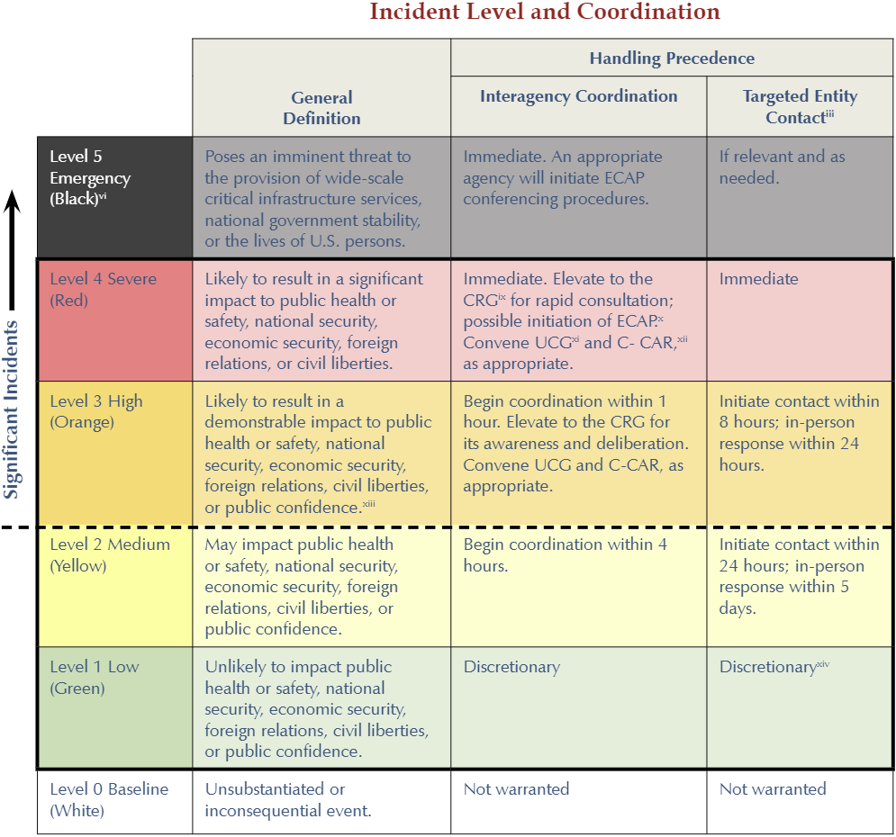
Cyber Incident Severity Schema

Slide 16
Skillsets and Capabilities
Skillsets | Capabilities
Operating System environments Networking concepts and technologies Network security assessment techniques and procedures Industry standard security certifications include Net + Sec+ Linux+ CEH CCNA CISSP GCFA GCIH GCED
Shared Situational Awareness – share, receive, filter/tearline, and broker cyber threat intelligence reports to/from the Customer, OTFC, ORNG JOC, ESO SOC, JRIC, NGCC, DHS NCCIC, NSA NTOC, and others
Network Scanning and Mapping - generate an independent, third-party perspective on the number, and types, of assets on the Customer’s network
Network Information Assurance Vulnerability Assessment (IAVA) Scan - scan the Customer systems for known vulnerabilities and common misconfigurations
Wireless Network Scan - ensure that all wireless hardware and networks are properly configured and secured using current best practices
Audit Log Review - ensure that proper logs are kept on activity within the network
Firewall Review - verify firewall configurations, status of ports and the authorization of services/data flow running through the ports
Network Security Procedural Review - consult with the Customer on the current Security Management Posture of the network; identify security managers, security management procedures, limitations in management of the network (training, Hardware /software deficiencies, personnel); provide recommendations to enhance network security management posture
Physical Security Review - a non-invasive, comprehensive examination of the physical security controls
Network Security Education - consult with the Customer on any additional training that is needed to enhance security posture of the network
Website Vulnerability Assessment (UPON REQUEST) - provide Customer with a passive scan of hosted websites in order to validate the security of web applications utilizing open source tools.

Slide 17
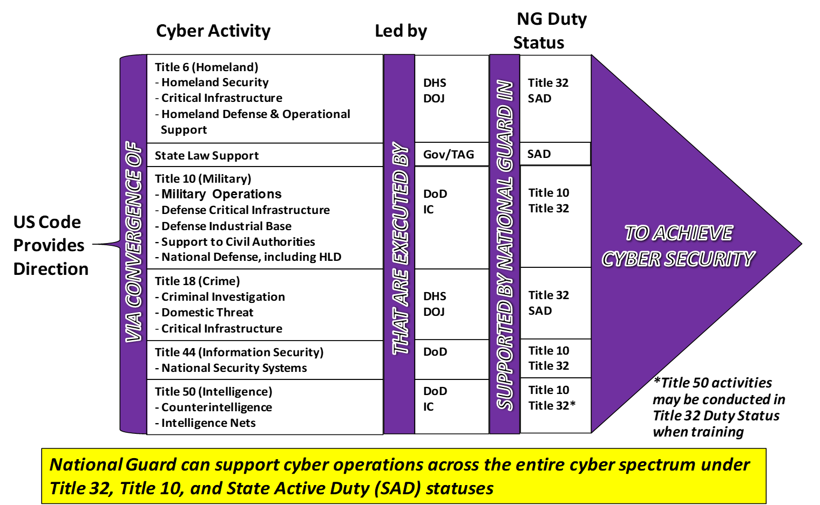
Cyber Activities and Authorities

Slide 18
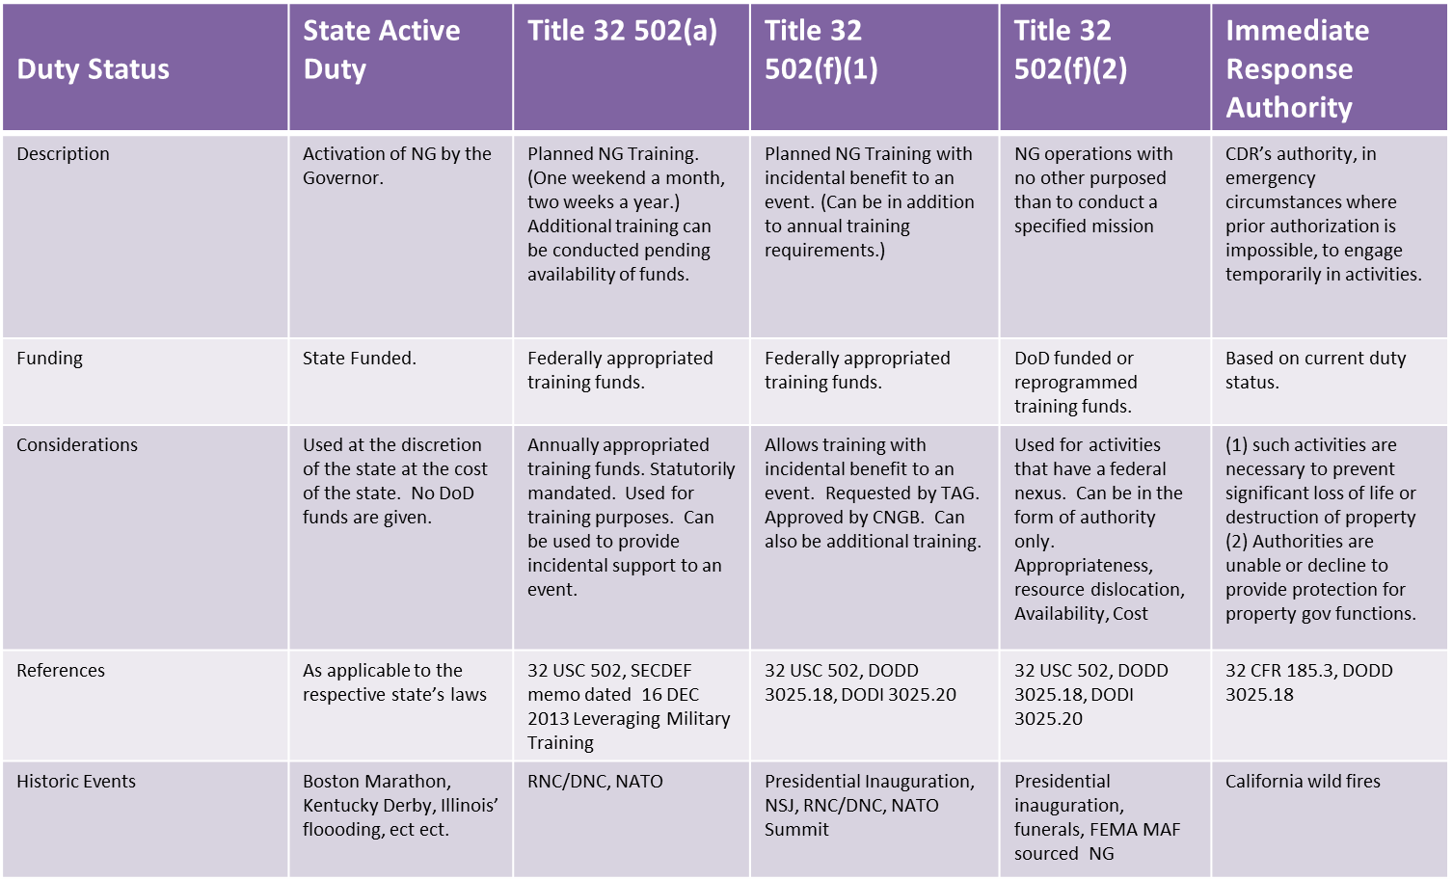
Funding

